Slide 1
Software QA and Testing with Automation using Selenium WebDriver Course 1, Class 5 Deck 1 Selenium WebDriver
Instructor
David F Wagoner
PMP, CSQE, CMQ/OE
Copyright 2015 Montgomery College, David F Wagoner

Slide 2
Objectives
Use Selenium WebDriver and the Python language to automate web site testing
Use modular structure for test scripts and suites
Use external data sources (spreadsheets, databases) to feed data for testing web page forms and elements
Use Test Runner to automate a suite of tests
Generate Test Reports

Slide 3
Prerequisites - Python
Go to
https://www.python.org/
Click on Downloads
Download and install latest Windows Release

Slide 4
Prerequisites
Install Selenium Python Bindings on your PC
Go to a command window
Type
pip install –U selenium
We’re going to use the PyCharm IDE but you can use any IDE for coding
WebDriver documentation
selenium.googlecode.com/git/docs/api/py/api.html

Slide 5
PyCharm
Download Community Edition from here:
https://www.jetbrains.com/pycharm/download/
Install and then open. We’ll walkthrough setup in class

Slide 6
Lab
Using PyCharm
Configuration
Show line numbers

Slide 7
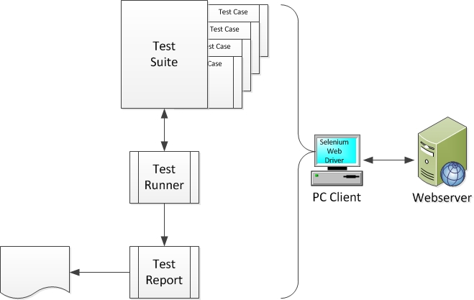
WebDriver Structure

Slide 8
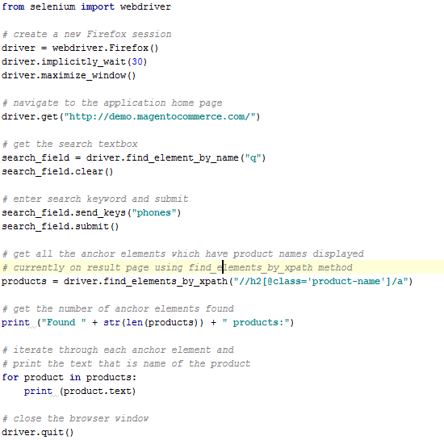
Lab 1 - Simple Test; Firefox

Slide 9


Lab 2 - Simple Test; Chrome
Download the IE driver
http://chromedriver.storage.googleapis.com/index.html
copy it to the folder where you are storing scripts and extract the file
Replace the following code and save to a new file name:
Change this to that

Slide 10
Register a User
Save your script to a new name and delete old content after import line
Create code per following slides

Slide 11
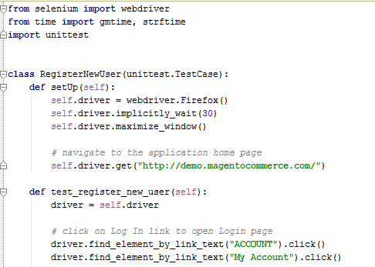
Lab Page 1 - Setup

Slide 12
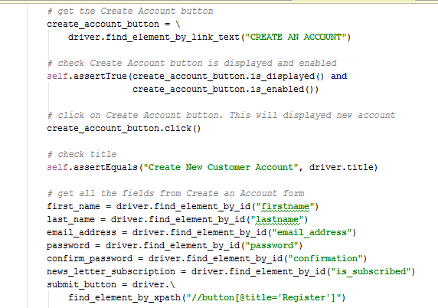
Lab Page 2 – Get Field Ids

Slide 13
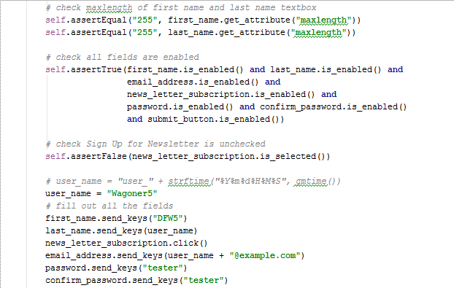
Lab Page 4 – Verify/Submit Fields

Slide 14
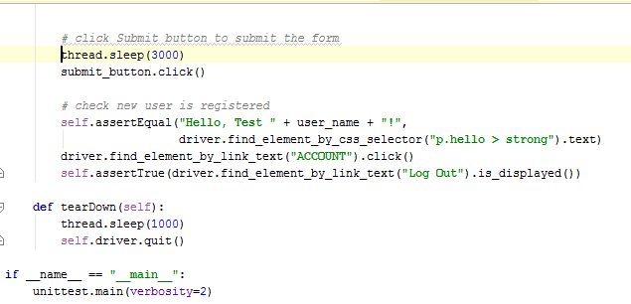
Lab Page 5 - Submit

